Slide 1
Radioactivity
  U, Th, K are unstable elements that continuously emit radioactivity In the form of alpha, Beta and Gamma rays.
Alpha :
    Relatively heavy partials with positive charge.
    Because of its mass and slow speed, it has little penetrating ability.
    They travel only few centimeters in air before they are stopped.
    They are not detected by Gamma ray tool.
Beta :
    Has mass charge and speed of a high speed electron.
    A unit of negative charge emitted at high speed but has little penetrating power.
    Gamma ray tool is not influenced by this type of radiation.

Slide 2
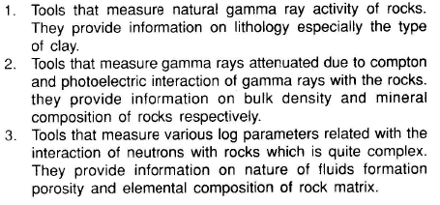
The most common nuclear radiation logging tool falls under the following categories:

Slide 3
Characteristics of Nuclear Radiation:
Radioactive decay

Slide 4
Gamma ray(s):
    Gamma radiations are electromagnetic waves of energy, similar to the of light and radio waves, having no mass .
    They have energy span of approximately 0.04 to 3.2 MeV and are very high Penetration. The average burst of gamma rays is around 1.0 MeV
    Gamma rays can be detected even after passing through several inches of steel.

Slide 5
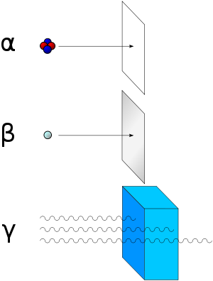
Paper
Thin steel plate
Thick steel plate

Slide 6
K, U, Th where these elements found?
Zones containing potassium feldspar
(i.e., Granites, Felsptic sands)
Volcanic and igneous rocks
Sands containing volcanic ash
Clays

Slide 7
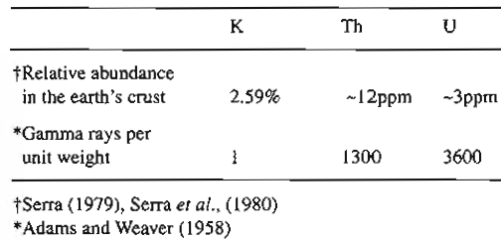
Relative Abundance of radio active minerals in the Earths Crust

Slide 8
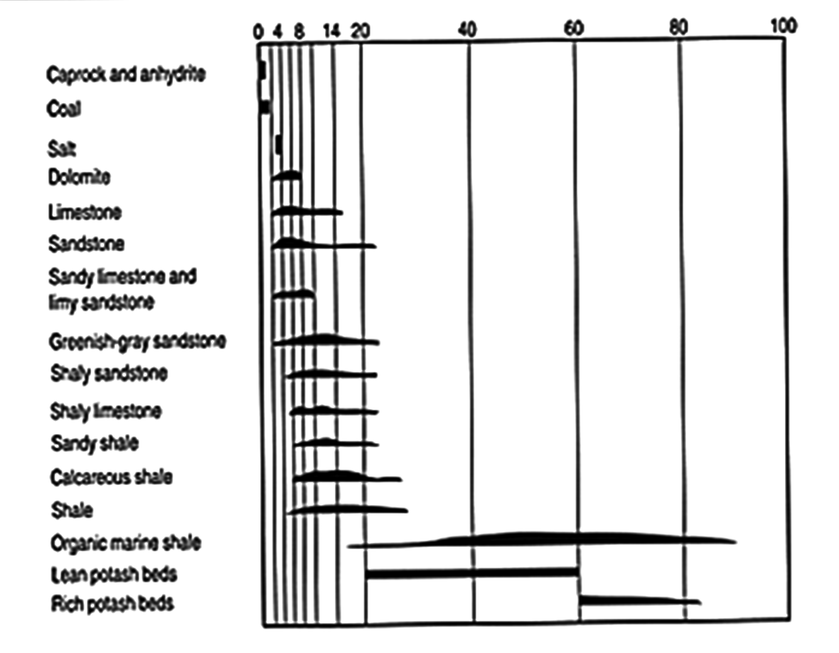

Slide 9
Ionization chamber
It consists of a gas filled cylindrical metal shell containing a central rod maintained at 100 volt positive to the cylindrical wall.
The incident GR Interact with the cylinder material or gas maintained at high pressure in order to produce a high speed electron.
The high electron drawn to the positively charged Center rod, provides additional electrons and ions in the collision with the atoms.
The electrons and ions in the collision with the atoms. The electrons moving to the center electrode constitute a minute flow of electric current, The size of Which is proportional to the number of gamma ray in Long chamber length –vertical resolution suffer with chamber length.
High gas pressure Low efficiency

Slide 10
GM Counter
Similar to the ionization chamber. It also contains a positive central rod.
Difference: low pressure- central electrode high positive voltage ( 900 to 1000 volts).
Incident GR cause ejection of electrons from detector wall into the gas.
As ejected electron is drawn toward the highly Charged central electrode, other collisions occur between each collision and gas atoms, thus producing additional electrons which in turn causes additional ionization by collision.
Relatively long counter
Low efficiency 5 to 10%

Slide 11
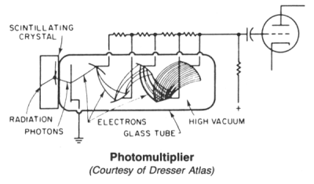
Scintillation Counter
Detector is a Thallium doped sodium iodide crystal.
Crystal emits light when it absorbs a Gamma ray
Light emits, and the light is multiplied with the help of
Photomultiplier tube. These are displayed as counts per second.

Slide 12
A scintillation detector uses a scintillation crystal made of a material like thallium sodium Iodide.
The crystal converts incoming gamma rays into photons of light using a process called “scintillation”.
The photons of light emitted by the scintillation crystal are detected by a photo-multiplier tube.
The photo-multiplier tube converts photons into millions of electrons thru a “photo-electric process”.
Gamma ray photons remove electrons from a photo sensitive surface within the tube.
Electron multiplication occurs as electrons are produced and successive stages of “dynode” electrodes within the photo-multiplier tube further amplify the photon “pulses”.
The resulting output is in the form of electrical pulses representing the detected back-scattered gamma rays.

Slide 13
Gamma Ray Log
Introduced in 1930. - First radioactive log.
Can be used both in open hole and cased hole.
Empty hole, oil, gas and water in bore hole.
Shales &Clays are responsible for most natural radioactivity.
GR is good indicator of such rocks.
The larger GR cps lager clay content.
The smaller cps, the smaller clay contents.
Units: API counts

Slide 14
Principle of Measurement
Today, most gamma ray tools use a scintillation detector and photomultiplier tube (PM) as the detection system.
The sensor is a sodium-iodide crystal that emits a burst of light when struck by a gamma ray.
Within the PM tube is a photosensitive surface that gives off electrons when exposed to light.
The crystal is optically coupled to the PM tube and as the crystal absorbs a gamma ray, electrons exit the photosensitive surface.
The PM anodes, each at a progressively more positive potential, attract electrons and give off about 3 electrons for each electron striking the anode.
The pulse generated is amplified, shaped, and sent to the instrumentation that scales and statistically averages the data.

Slide 15
Advantages
High efficiency 50-60% GR detection
Short detector length( 4”)- good formation delineation
selectivity- narrow range of GR energy can be measured
Disadvantage
Temp of the tube must be closely controlled
High temp can cause random counts

Slide 16
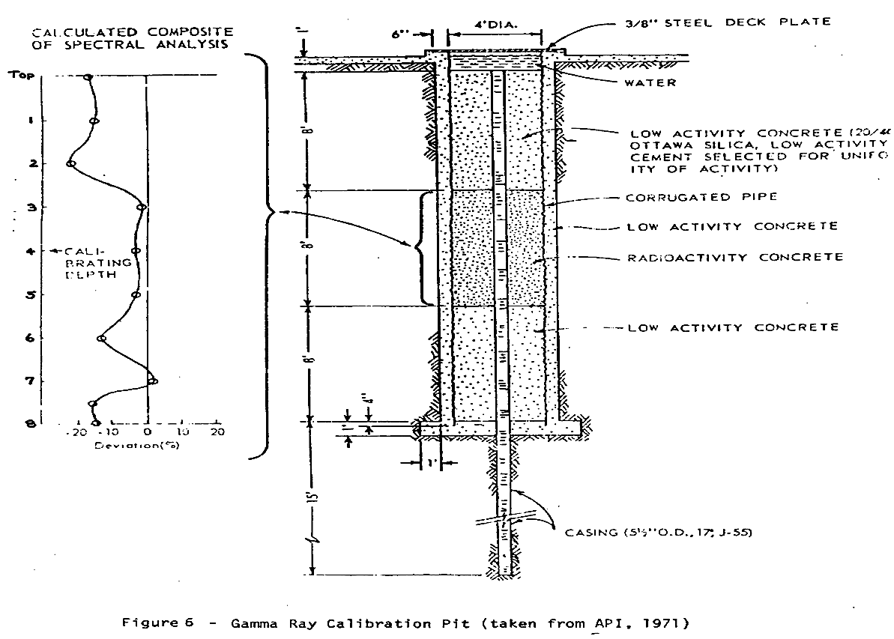

Slide 17
Cased Holes
Most of the gamma rays emitted by the formation can penetrate casing, so that a gamma ray curve can be obtained in cased holes, although the amplitudes of the curve are somewhat reduced.
For example, a 5/16 inch thickness of steel reduces the gamma ray intensity about one fourth.

Slide 18
Comparison of
Open hole & cased hole GR log

Slide 19
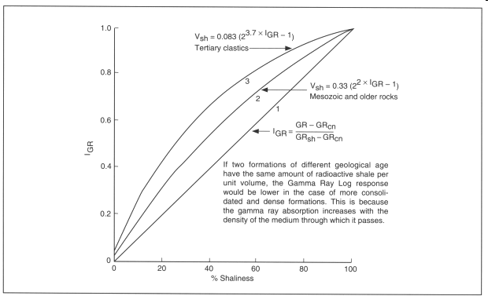

Slide 20
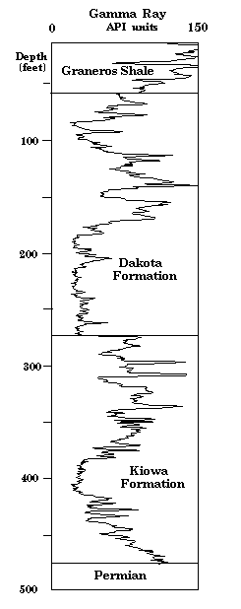

Slide 21
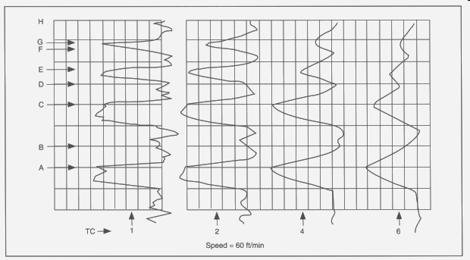
Recorded with different speeds

Slide 22
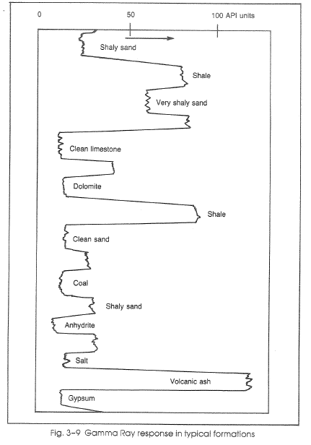
Natural Gamma Ray Log
J.T. Dewan
“Modern Open-Hole Log Interpretation”, p52

Slide 23
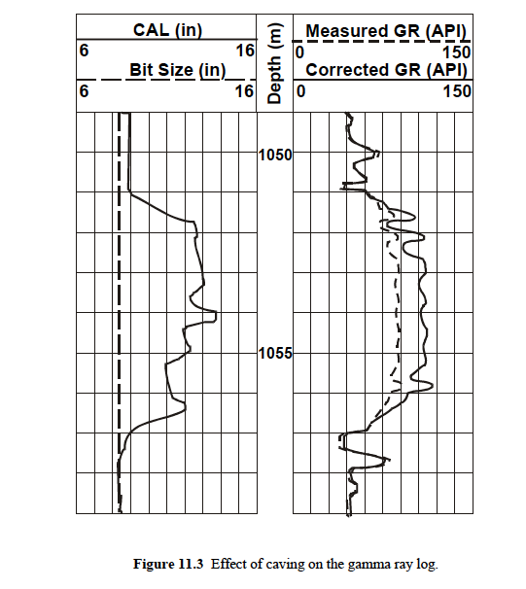
Glover’s Petrophysique

Slide 24
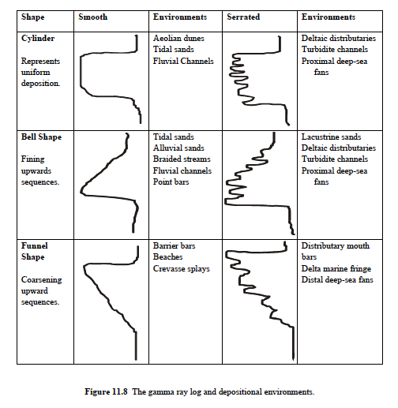
Glover’s Petrophysique

Slide 25
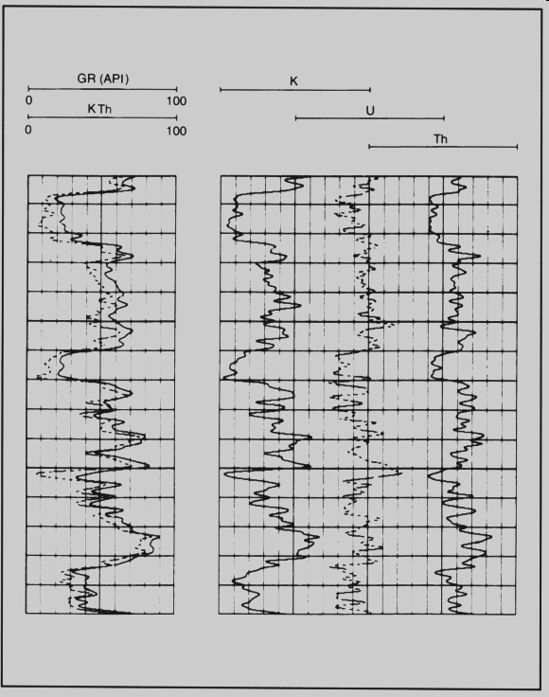

Slide 26
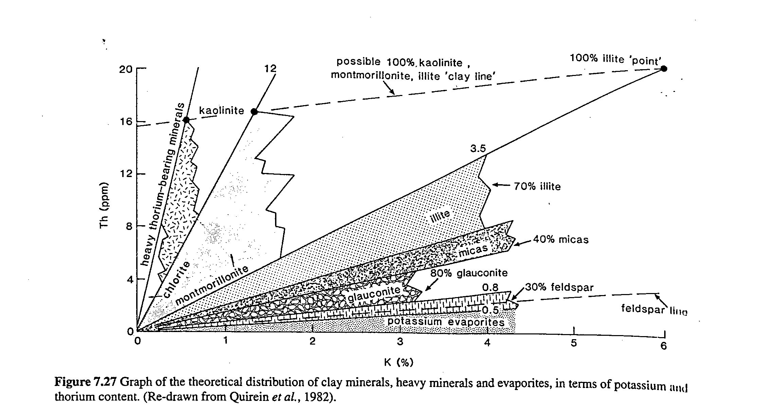
Qualitative + semi-quantitative uses of the spectral gamma
dominant clay mineral + detrital mineral content
Use of the Th/K ratio

Slide 28
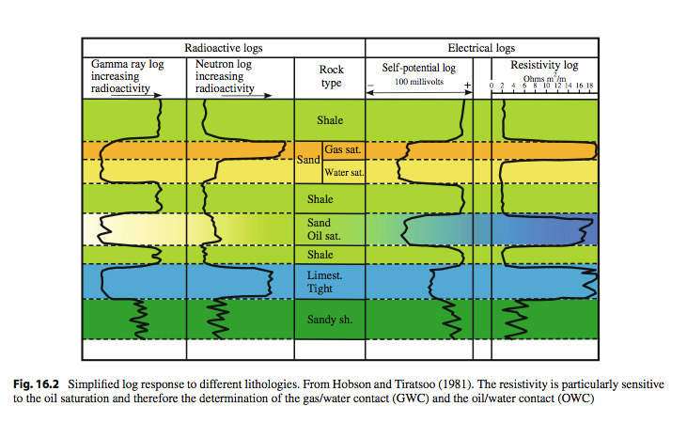

Note the use of “sand” in
petroleospeak for what most
of us would probably consider
a sandstone.
Note that a deflection to the left
(little radioactivity) only means
“not shale”, not permeability.

Slide 30
Uses of Gamma Ray Log
Lithology identification
Estimation of Shalyness
Identification of mineral deposited K, U ,Th and coal
Radioactive monitoring
For accurate perforation, placing packers etc.
Identification of bed boundary
Stratigraphic correlation in open hole & incased hole

Slide 31
Application of Gamma Ray Logs
Gamma ray logs are also used in the following instances.
To log cased holes (no electric log can be obtained in cased holes).
To log dry holes (no electric log can be obtained in holes that do not contain water or mud).
To log holes containing salt water or salty mud (the electric logs obtained in such holes are generally poor).
To supplement the information given by the electric log (identification of formations,
To help locate lignite and coal beds.

Slide 32
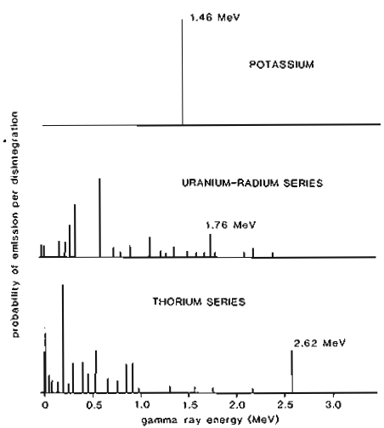

Spectral Gamma ray logs

Slide 33
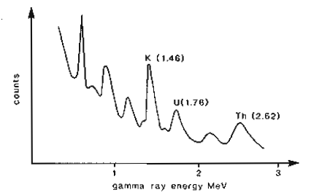

Spectral Gamma ray logs

Slide 34
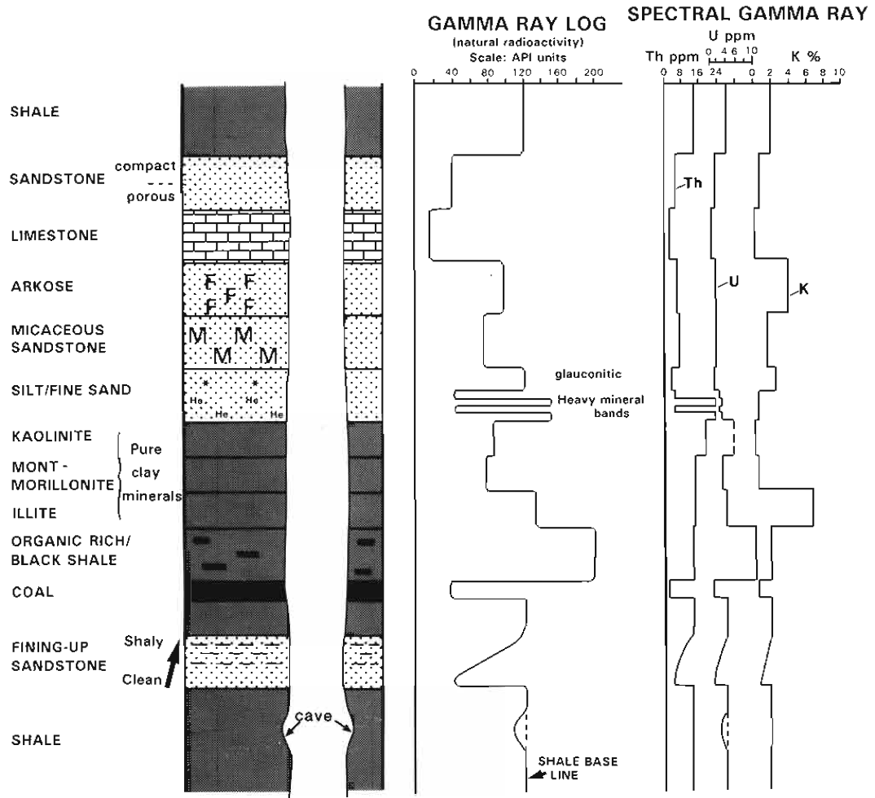
Spectral Gamma ray logs

Slide 35
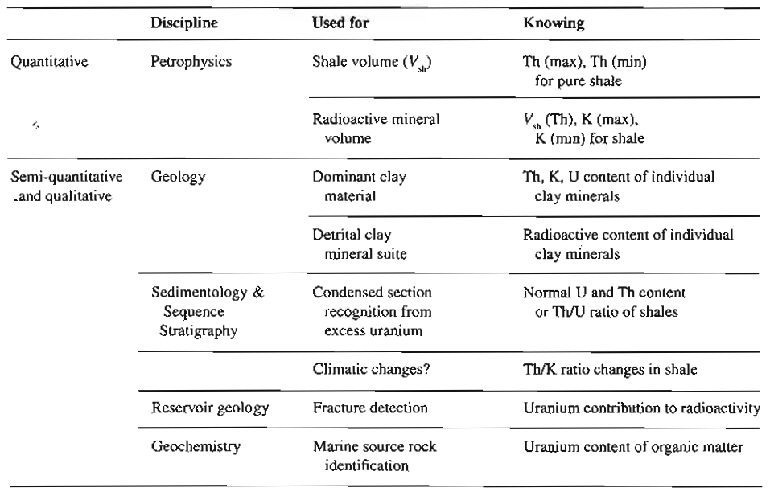
Spectral Gamma ray logs and their uses

Slide 36
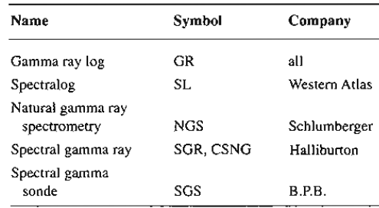
Gamma ray logging tools

Slide 37
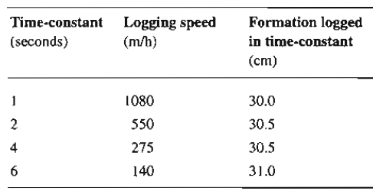
Logging speed Vs. Time constant –Simple Gamma ray tool

Slide 38
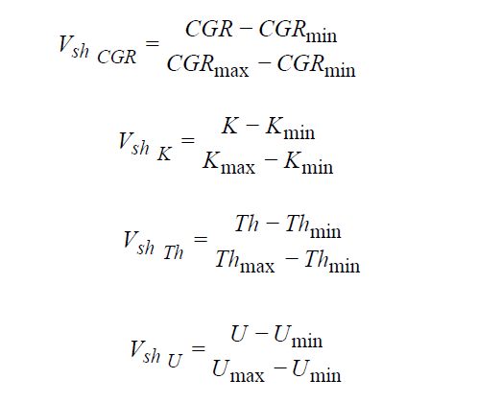
Calculation of Shale Volume

